Slide 1
Lecture 7
INCEPTION

Slide 2
Questions?
What is the vision and business case for this project?
Feasible?
Buy and/or build?
Rough estimate of cost: Is it $10K-100K or in the millions?
Should we proceed or stop?

Slide 3
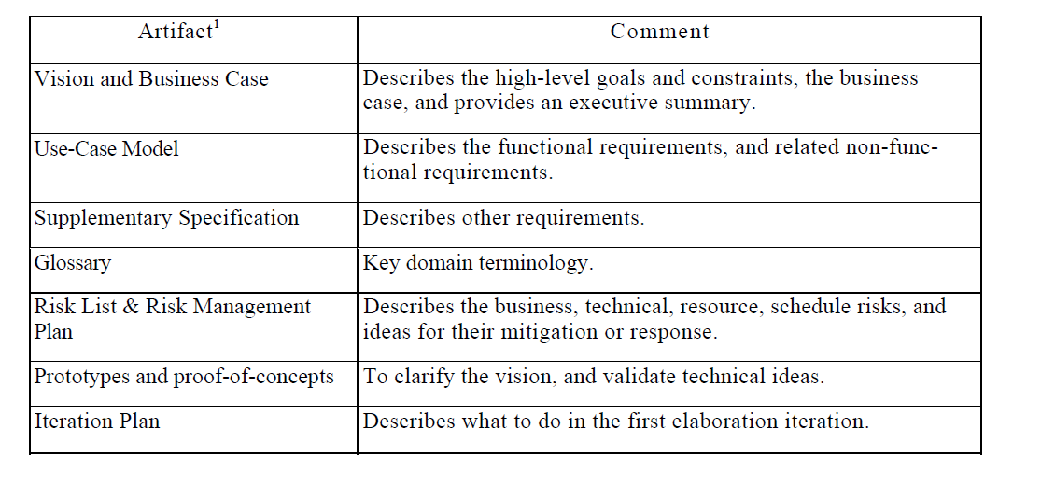
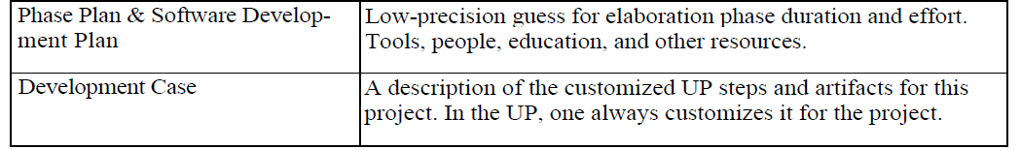
What Artifacts May Start in Inception?

Slide 4
Use Case Modeling
Practical Way of Doing

Slide 5
Agenda
Identify and write use cases.
Relate use cases to user goals and elementary business processes.
Use the brief, casual, and fully dressed formats, in an essential style.
Relate use case work to iterative development.

Slide 6
Introduction
The UP defines the Use-Case Model within the Requirements discipline.
Essentially, this is the set of all use cases; it is a model of the system's functionality and environment

Slide 7
Use Case Diagrams
A formal way of representing how a business system interacts with its environment
Illustrates the activities that are performed by the users of the system
A scenario-based technique in the UML
A sequence of actions a system performs that yields a valuable result for a particular actor

Slide 8
Use Case Analysis
What is an Actor?
A user or outside system that interacts with the system being designed in order to obtain some value from that interaction
Use Cases describe scenarios that describe the interaction between users of the system (the actor) and the system itself.

Slide 9
Use Cases
Use case diagrams describe what a system does from the standpoint of an external observer. The emphasis is on what a system does rather than how.
Use case diagrams are closely connected to scenarios. A scenario is an example of what happens when someone interacts with the system.

Slide 10
Use Cases
Here is a scenario for a medical clinic.
A patient calls the clinic to make an appointment for a yearly checkup. The receptionist finds the nearest empty time slot in the appointment book and schedules the appointment for that time slot. "
We want to write a use case for this scenario.
Remember: A use case is a summary of scenarios for a single task or goal.

Slide 11
Use Cases
Step 1 Identify the actors
As we read the scenario, define those people or systems that are going to interact with the scenario.
A patient calls the clinic to make an appointment for a yearly checkup. The receptionist finds the nearest empty time slot in the appointment book and schedules the appointment for that time slot. "

Slide 12
Use Cases
Step 1 Identify the actors
As we read the scenario, define those people or systems that are going to interact with the scenario.
A patient calls the clinic to make an appointment for a yearly checkup. The receptionist finds the nearest empty time slot in the appointment book and schedules the appointment for that time slot. "

Slide 13
Questions for Identifying People Actors
Who is interested in the scenario/system?
Where in the organization is the scenario/system be used?
Who will benefit from the use of the scenario/system?
Who will supply the scenario/system with this information, use this information, and remove this information?
Does one person play several different roles?
Do several people play the same role?
Notes:
Actors
7) Does one person play several different roles?
May have an actor for each role
8) Do several people play the same role?
Only use one actor per role (no matter how many people play that role)
Identifying actors is an iterative process
Defining how an actor interacts with the system may clarify whether there are duplicate actors or not

Slide 14
Questions for Identifying Other Actors
What other entity is interested in the scenario/system?
What other entity will supply the scenario/system with this information, use this information, and remove this information?
Does the system use an external resource?
Does the system interact with a legacy system?
Notes:
Actors
7) Does one person play several different roles?
May have an actor for each role
8) Do several people play the same role?
Only use one actor per role (no matter how many people play that role)
Identifying actors is an iterative process
Defining how an actor interacts with the system may clarify whether there are duplicate actors or not

Slide 15
Actors
An Actor is outside or external the system.
It can be a:
Human
Peripheral device (hardware)
External system or subsystem
Time or time-based event
Represented by stick figure
Notes:
Actors
Are NOT a part of the system (external to the system)
A single actor may represent multiple physical users
Whether human or not, represented by stick figure
MUST label stick figure with the name of the actor

Slide 16
Use Cases
A use case is a summary of scenarios for a single task or goal.
An actor is who or what initiates the events involved in the task of the use case. Actors are simply roles that people or objects play.
So as we read our scenario, what or who is the actor????

Slide 17

Use Cases
So as we read our scenario, what or who is the actor????
A patient calls the clinic to make an appointment for a yearly checkup. The receptionist finds the nearest empty time slot in the appointment book and schedules the appointment for that time slot. "
The actor is a Patient.

Slide 18
Use Cases
The use case is a summary of scenarios for a single task or goal.
So What is the Use Case????
The Use Case is Make Appointment.
It is a use case for the medical clinic.

Slide 19

Use Cases
The picture below is a Make Appointment use case for the medical clinic.
The actor is a Patient. The connection between actor and use case is a communication association (or communication for short).
Actors are stick figures. Use cases are ovals. Communications are lines that link actors to use cases.
Actors are stick figures. Use cases are ovals. Communications are lines that link actors to use cases.

Slide 20
Use Case Componentss
The use case has three components.
The use case task referred to as the use case that represents a feature needed in a software system.
The actor(s) who trigger the use case to activate.
The communication line to show how the actors communicate with the use case.

Slide 21
Use Case Diagram - Use Case
A major process performed by the system that benefits an actor(s) in some way
Models a dialogue between an actor and the system
Represents the functionality provided by the system
Notes:
Use Case
Represent the user functionality (not system functionality)

Slide 22
Use Case
Each use case in a use case diagram describes one and only one function in which users interact with the system
May contain several “paths” that a user can take while interacting with the system
Each path is referred to as a scenario
Notes:
Use Case
In reading a use case, you should not be able to tell if an activity is computerized or manual
Used to document the current system (AS-IS system) or the new system being developed (TO-BE system)
Communicates at a high level what the system needs to do
Captures the typical interaction of the system with the system’s users
Logical model
Physical details are defined during the design phase

Slide 23
Use Case
Labelled using a descriptive verb-noun phrase
Represented by an oval
Make
Appointment
Notes:
Use case: A use case in a use case diagram is a visual representation of a distinct business functionality in a system. The key term here is "distinct business functionality." To choose a business process as a likely candidate for modeling as a use case, you need to ensure that the business process is discrete in nature. As the first step in identifying use cases, you should list the discrete business functions in your problem statement. Each of these business functions can be classified as a potential use case. Remember that identifying use cases is a discovery rather than a creation. As business functionality becomes clearer, the underlying use cases become more easily evident. A use case is shown as an ellipse in a use case diagram Depicted by an oval
MUST label the oval with the name of the use case

Slide 24
Use Case - Actor
Labelled using a descriptive noun or phrase
Represented by a stick character
Notes:
Actors: An actor portrays any entity (or entities) that performs certain roles in a given system. The different roles the actor represents are the actual business roles of users in a given system. An actor in a use case diagram interacts with a use case. For example, for modeling a banking application, a customer entity represents an actor in the application. Similarly, the person who provides service at the counter is also an actor. But it is up to you to consider what actors make an impact on the functionality that you want to model. If an entity does not affect a certain piece of functionality that you are modeling, it makes no sense to represent it as an actor. An actor is shown as a stick figure in a use case diagram depicted "outside" the system boundary, as shown in Make Appointment figure.
Depicted by an oval
MUST label the oval with the name of the use case
To identify an actor, search in the problem statement for business terms that portray roles in the system. For example, in the statement "patients visit the doctor in the clinic for medical tests," "doctor" and "patients" are the business roles and can be easily identified as actors in the system.

Slide 25
Use Case - Relationships
Relationships
Represent communication between actor and use case
Depicted by line or double-headed arrow line
Also called association relationship
Make
Appointment
Notes:
Use Case Relationship
Association relationship
May exist between actor and a use case
Often referred to as a communicate association
Navigable in both directions (actor to use case and use case to actor)
Some use just a line
Others use a double-headed arrowhead
Navigable in only one direction (actor to use case OR use case to actor)
Use a arrowhead where arrowhead denotes the direction of communication
Navigation direction of an association represents who is initiating the communication
Multiplicity
Not consistency shown on all use-case diagrams (Some do; some don’t)

Slide 26
Use Case - Relationships
Boundary
A boundary rectangle is placed around the perimeter of the system to show how the actors communicate with the system.
Make
Appointment
Notes:
System boundary: A system boundary defines the scope of what a system will be. A system cannot have infinite functionality. So, it follows that use cases also need to have definitive limits defined. A system boundary of a use case diagram defines the limits of the system. The system boundary is shown as a rectangle spanning all the use cases in the system.
Other use cases in this lecture also show the system boundary of the clinic application. The use cases of this system are enclosed in a rectangle. Note that the actors in the system are outside the system boundary.
The system boundary is potentially the entire system as defined in the problem statement. But this is not always the case. For large and complex systems, each of the modules may be the system boundary. For example, for an ERP system for an organization, each of the modules such as personnel, payroll, accounting, and so forth, can form the system boundary for use cases specific to each of these business functions. The entire system can span all of these modules depicting the overall system boundary.

Slide 27
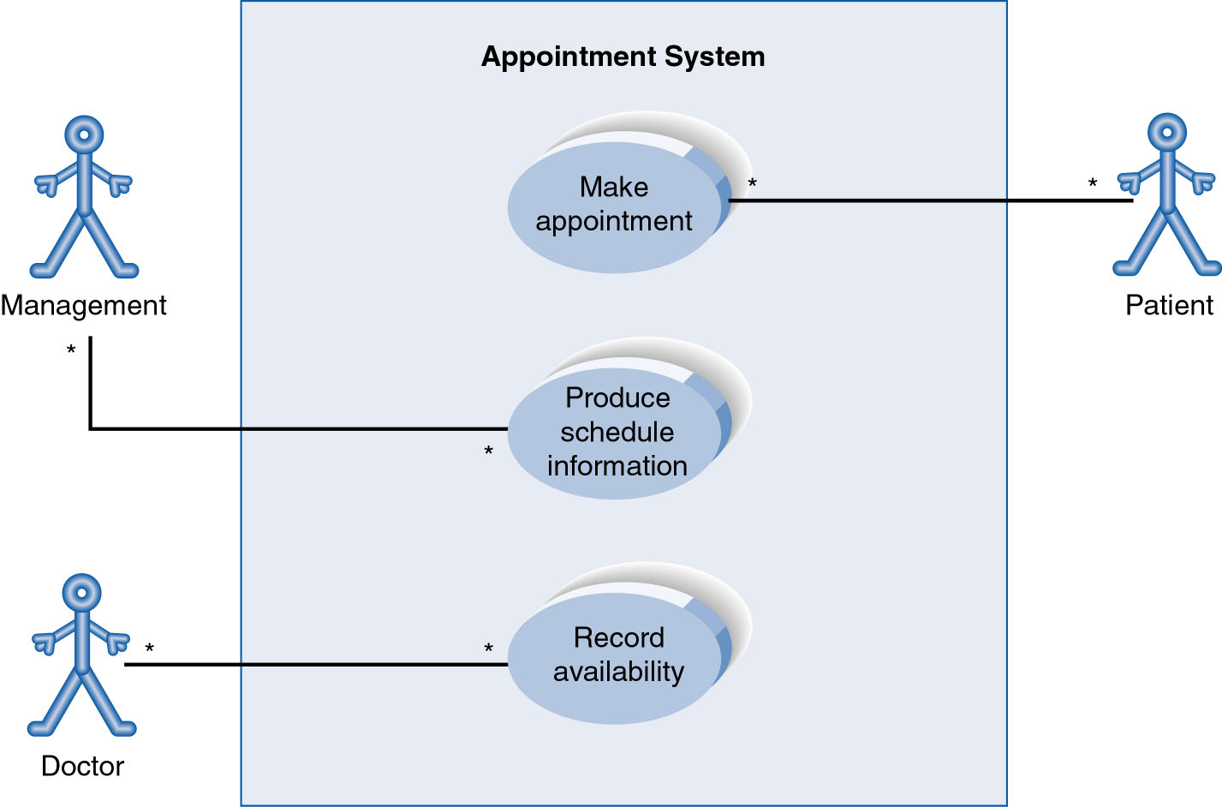
Use-Case Diagram
A use case diagram is a collection of actors, use cases, and their communications.
Notes:
Example Use Case
ACTORS
Represented by a stick figure
named
USE CASE
Represented by an oval
Named (POORLY NAMED; should be verb phrase)
RELATIONSHIP
2-way association

Slide 28
Use Case Diagram
Other Types of Relationships for Use Cases
Generalization
Include
Extend
Notes:
Inheritance

Slide 29
Components of Use Case Diagram
Generalization Relationship
Represented by a line and a hollow arrow
From child to parent
Child use case
Parent use case
Notes:
Inheritance
A use case generalization shows that one use case is simply a special kind of another.
A clinic may have a use case such as Pay Bill which would be a parent use case and Bill Insurance which is the child.
A child can be substituted for its parent whenever necessary.
Generalization appears as a line with a triangular arrow head toward the parent use case.

Slide 30
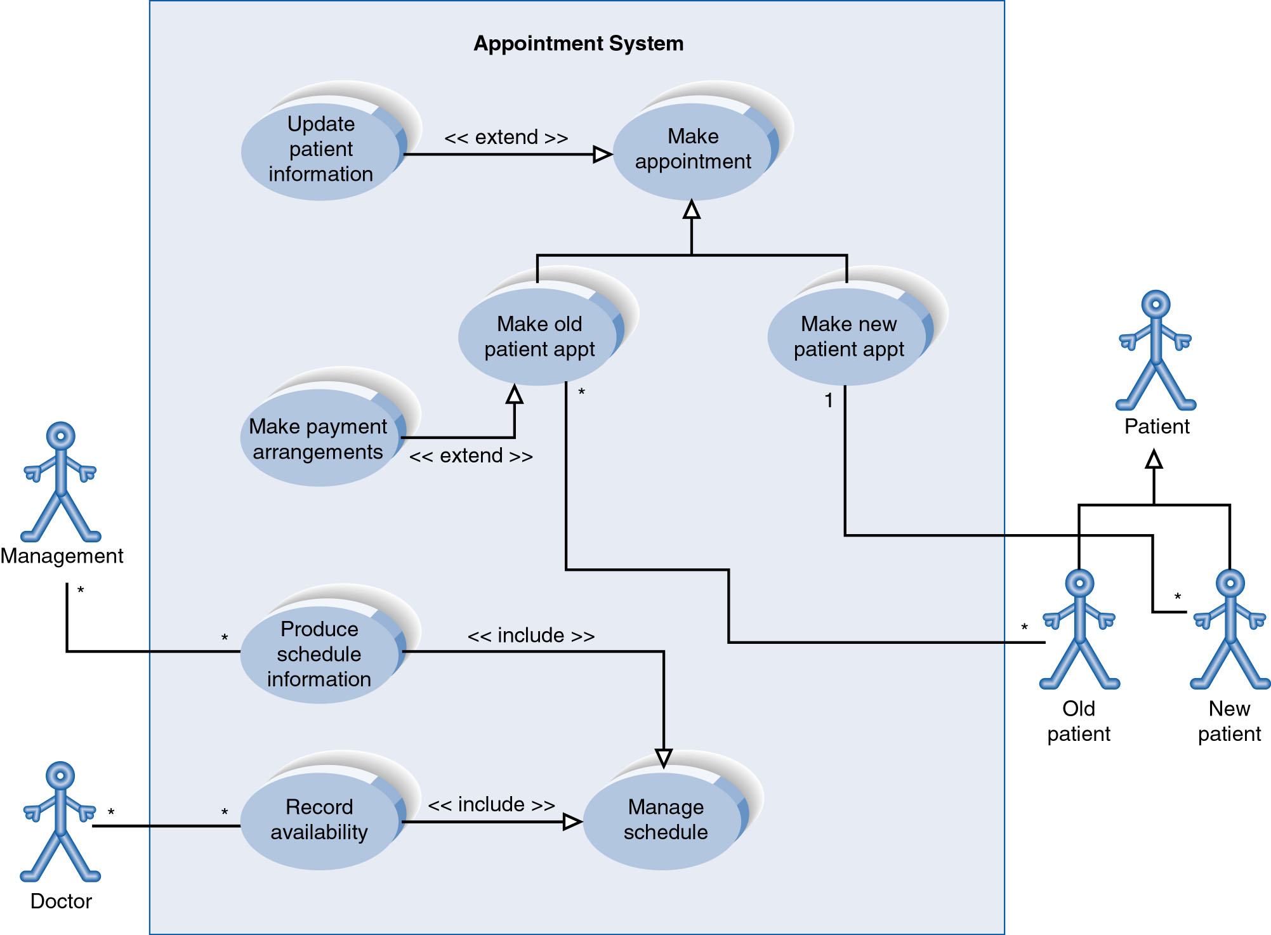
Example of Relationships
Notes:
System Boundary
Use cases are enclosed within a system boundary
a box that represents the system and clearly delineates what parts of the diagram are external or internal to it
Name of the system can appear inside or on top of the box

Slide 31
Use Case Diagram
Include Relationship
Represents the inclusion of the functionality of one use case within another
Arrow is drawn from the base use case to the used use case
Write << include >> above arrowhead line
Notes:
Include relationship
Notice that ONLY between use cases (not between actors)
MANDATORY functional
Multiple use cases may share pieces of the same functionality
Rather than have duplicate functionality in several use cases
Put shared functionality in one use case and show relationship between it and other use cases that “uses” its functionality
Depicted by arrowhead with word “<<include>>” above it
Include relationships factor use cases into additional ones.
Includes are especially helpful when the same use case can be factored out of two different use cases.
If a clinic had a cases of Make Appointment and Request Medication.
Both might include Check Patient Record as a subtask.
Both would include a call to the use case Check Patient Record.
We don’t want to write it twice we simply want to include in as a call from both.
In the diagram,
include notation is a dotted line beginning at base use case ending with an arrows pointing to the include use case.
The dotted line is labeled <<include>>.

Slide 32
Use Case Diagram
Extend relationship
Represents the extension of the use case to include optional functionality
Arrow is drawn from the extension use case to the base use case
Write << extend >> above arrowhead line
Notes:
Use Case Relationship
Extend relationship
Used to show optional behavior (behavior that is run only under certain circumstances)
Depicted by arrowhead with word “<<extend>>” above it
An extend relationship indicates that one use case is a variation of another.
This is often used when much of the same code may be in both only one extends the functionality somewhat.
A typical example is a add record to the database and modify that record.
So an add student is similar to a modify student so I may reuse some of the code.
Extend notation is a dotted line, labeled <<extend>>, and with an arrow toward the base case.
The extension point, which determines when the extended case is appropriate, is written inside the base case.

Slide 33
Example of Relationships
Notes:
System Boundary
Use cases are enclosed within a system boundary
a box that represents the system and clearly delineates what parts of the diagram are external or internal to it
Name of the system can appear inside or on top of the box

Slide 34
Use Case Relationships
Pro:
Reduces redundancy in use cases
Reduces complexity within a use case
Con
May introduce complexity to use case diagram
Notes:
Mainly talking about extend, include, and generalization relationships.
95% of relationships on a use case diagram is association

Slide 35
Benefits of Use Cases
Use cases are the primary vehicle for requirements capture in UP
Use cases are described using the language of the customer (language of the domain which is defined in the glossary)
Use cases provide a contractual delivery process (UP is Use Case Driven)
Use cases provide an easily-understood communication mechanism
When requirements are traced, they make it difficult for requirements to fall through the cracks
Use cases provide a concise summary of what the system should do at an abstract (low modification cost) level.

Slide 36
Difficulties with Use Cases
As functional decompositions, it is often difficult to make the transition from functional description to object description to class design
Reuse at the class level can be hindered by each developer “taking a Use Case and running with it”. Since UCs do not talk about classes, developers often wind up in a vacuum during object analysis, and can often wind up doing things their own way, making reuse difficult
Use Cases make stating non-functional requirements difficult (where do you say that X must execute at Y/sec?)
Testing functionality is straightforward, but unit testing the particular implementations and non-functional requirements is not obvious

Slide 37
Use Case Model Survey
The Use Case Model Survey is to illustrate, in graphical form, the universe of Use Cases that the system is contracted to deliver.
Each Use Case in the system appears in the Survey with a short description of its main function.
Participants:
Domain Expert
Architect
Analyst/Designer (Use Case author)
Testing Engineer

